Slide 1
Norways leading supplier of metals and plastic semi-finished

Slide 2
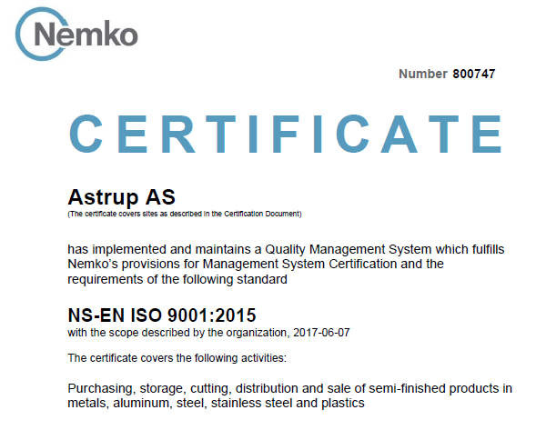
Our values
Astrup has been an important supplier for the Norwegian Industry for more than 160 years!
With Quality in our work, Diversity in our product range, and a Good cooperation with our clients and suppliers we make everyday easier for the Norwegian industry!
Certified according to NS-EN ISO9001:2015

Slide 3
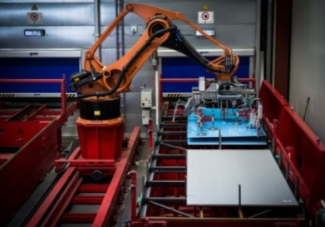
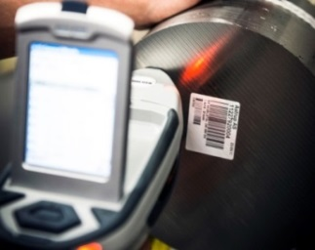
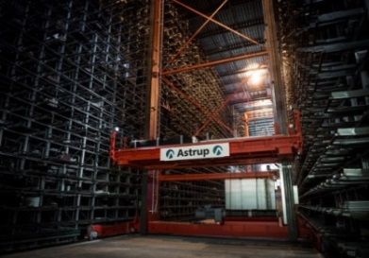
Our vision
"Based on tradition and innovation, Astrup will be the industry partner of the future for its customers and suppliers“
Astrup - your future industry partner

Slide 4
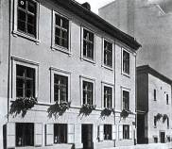
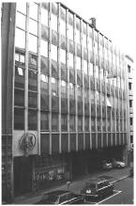
History & Key figures
Established in 1857
The Astrup family has run and owned the company for
five generations.
Key Figures 2020
Turnover NOK 737 mill
Share capital NOK 3 mill
Equity NOK 183 mill
Stock value NOK 153 mill
Number of employees 90

Slide 5
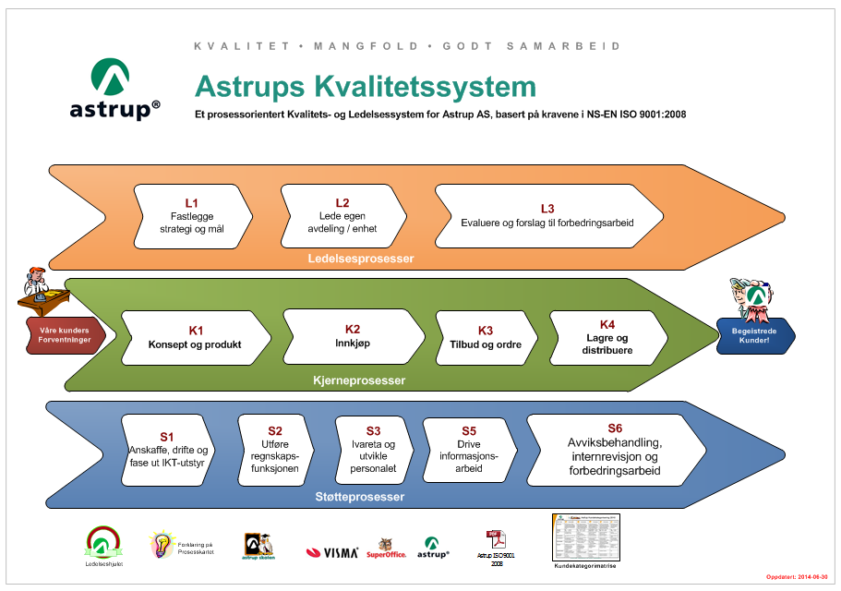
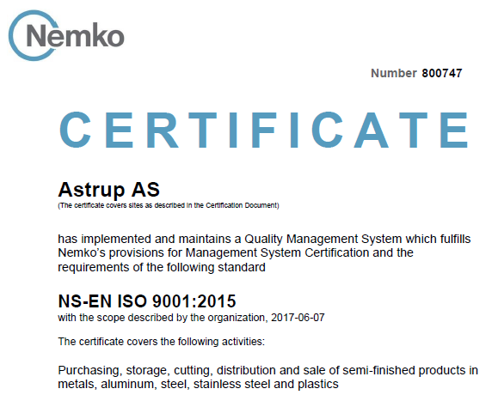
Quality System
Astrup AS has developed a Quality System in accordance with the requirements of NS-EN ISO 9001:2015, and it is based on process orientation.
An Astrup Management Model has been established, which provides a description of the organization's most important processes.
NS-EN ISO 9001:2015
Achilles Leverandør
Astrup AS har i mange år vært
registrert som pre-kvalifisert leverandør.

Slide 6
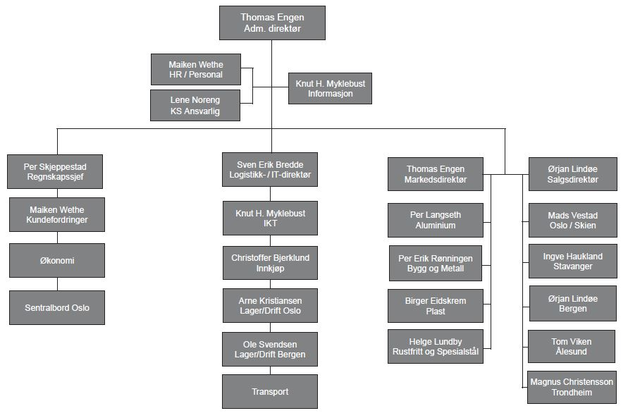
The organization Astrup AS

Slide 7
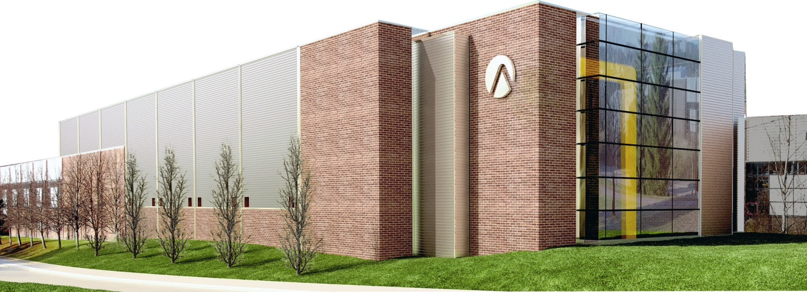
Main Office and Warehouse, Oslo
Modern office and warehouse, located at Rommen in Oslo, 17.500 m²
Approx. 90 employees within sale, marketing, warehouse, economy, IT and administration
Approx. 3000 articles on stock

Slide 8
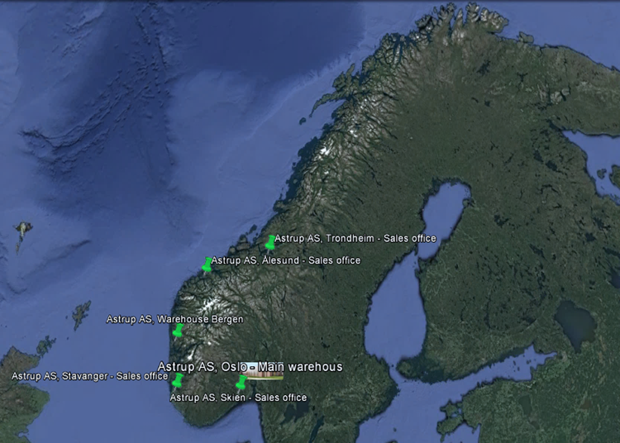
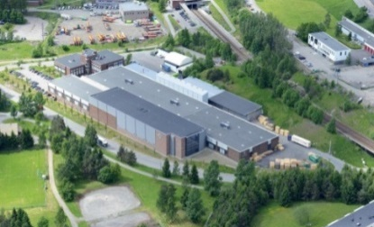
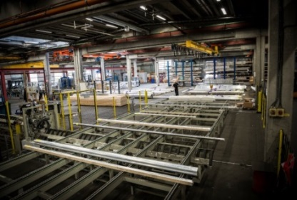
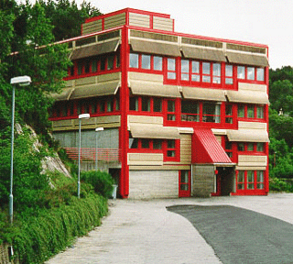
Our locations
Astrup AS, Oslo
Warehouse and sales office
Astrup AS, Bergen
Warehuse and sales office
Astrup AS, Skien
Sales office
Astrup AS, Stavanger
Sales office
Astrup AS, Ålesund
Sales office
Astrup AS, Trondheim
Sales office

Slide 9
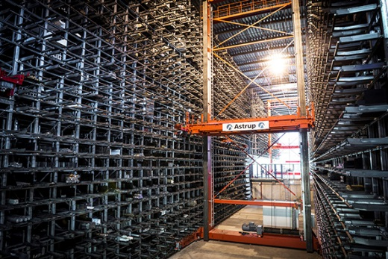
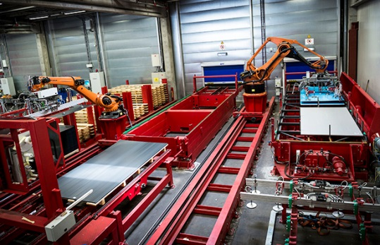
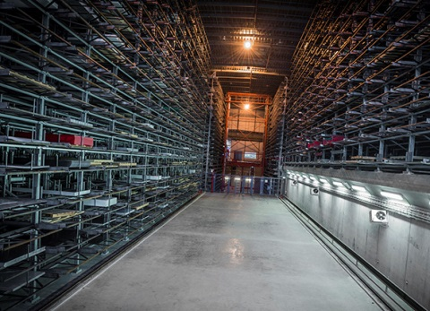
New and modern stock!
Astrup AS has built the most modern storage system for storing and handling both sheets and long products.
Our new storage system is 90 meters long, 23 meters wide and up to 19.5 meters high, and will contain 2,000 pallets for long products and 1,200 pallets for sheets/plates.

Slide 10
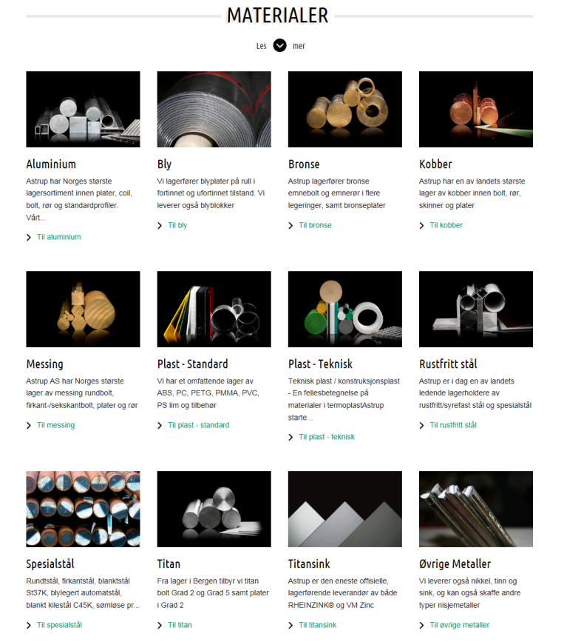
Metals & Plastic
Aluminium
Metals
Standard plastic
High-performance plastic
Stainless steel
Special steel
Titanium
Special profiles
Buildings systems

Slide 11
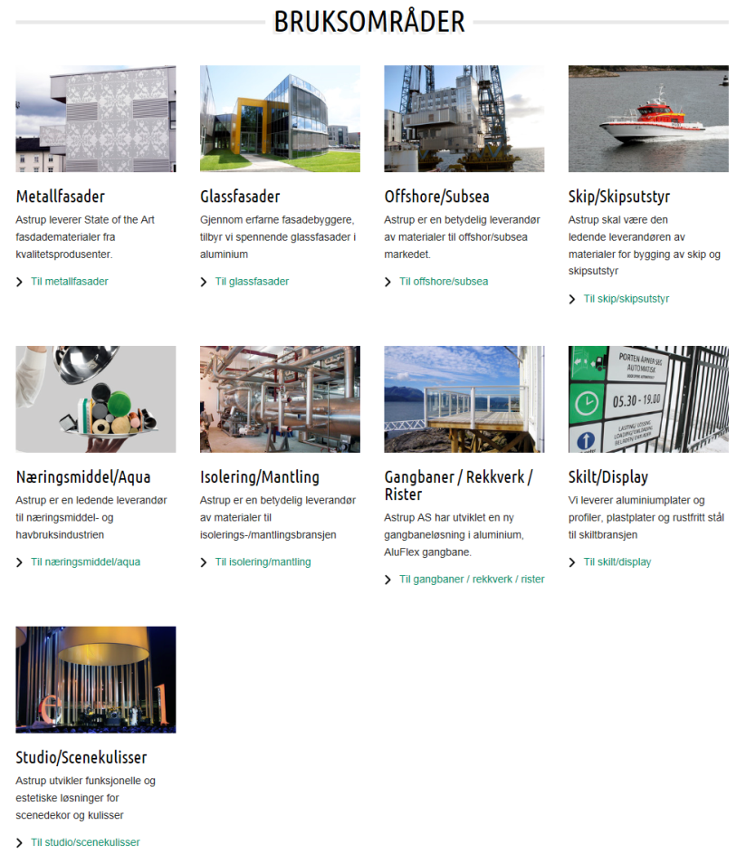
Market Segments
Astrup AS has divided the market into the following branches:
Machining
Sheets / Welding
Building Industry
Signs and Interiors
Electro

Slide 12
Machining
Steel
Titanium
Copper
Bronze
Brass
Aluminium
Plastics
Stainless Steel
Duplex/super duplex
Inconel® 625/718

Slide 13
Sheets / Welding
Construction
Aluminium
Stainless Steel
Plastic
Copper

Slide 14
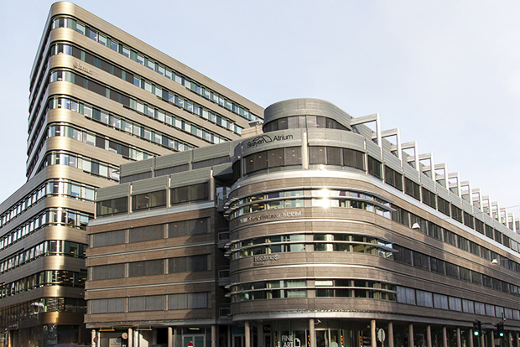
Building industry
Aluminium
Copper
Zink
Lead
Plastics
Stainless Steel
Facade systems
Roller lattice, railings and walkways
Building Systems

Slide 15
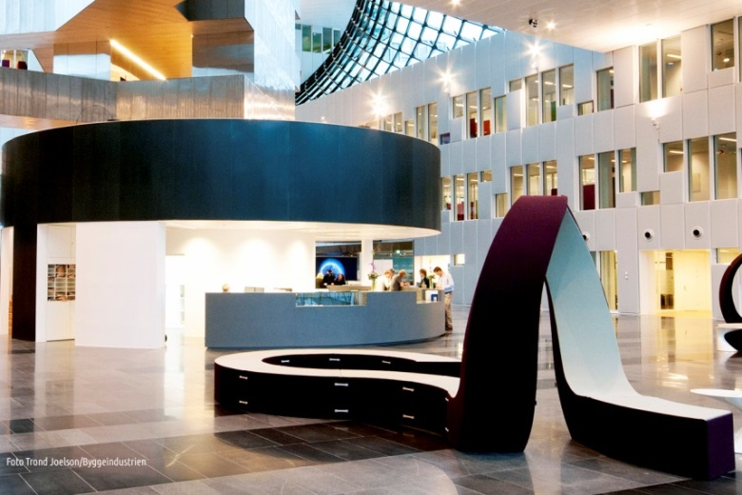
Sign and interiors
Sign
Display
Plastics
Aluminium
Brass
Stainless steel
RIMEX®

Slide 16
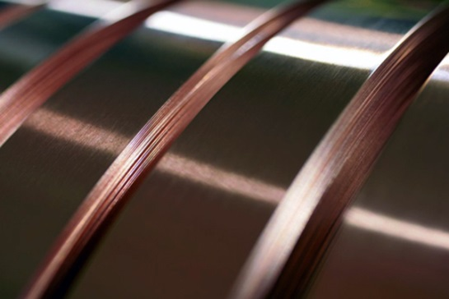
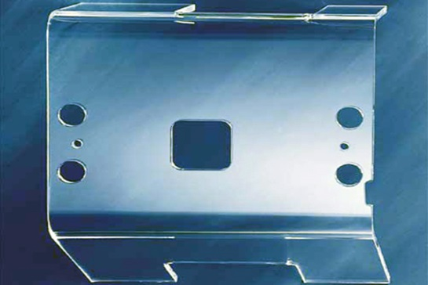
Electro
Electrical contractor
Workshop
Brass strips
Aluminium conductor rail
PVC sheets
PC sheets

Slide 17
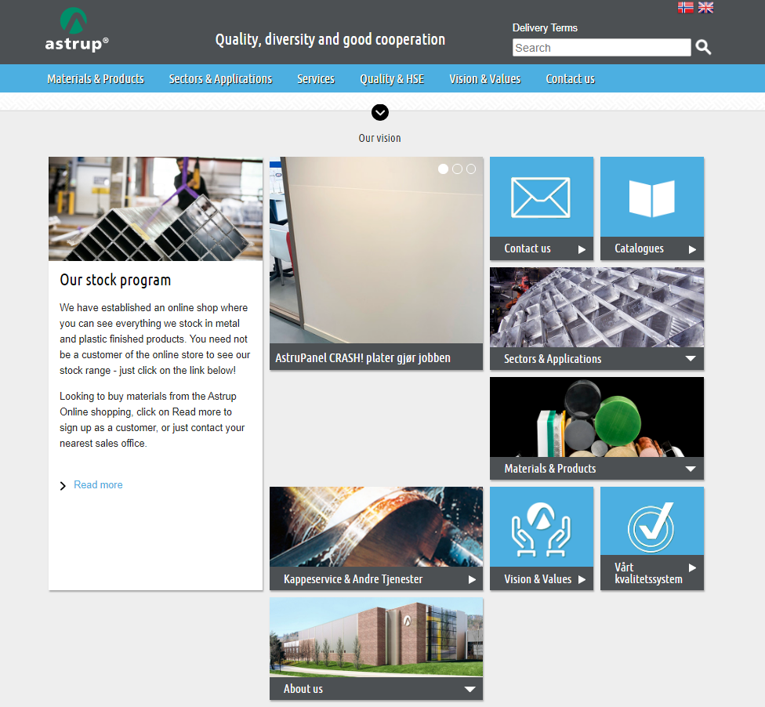
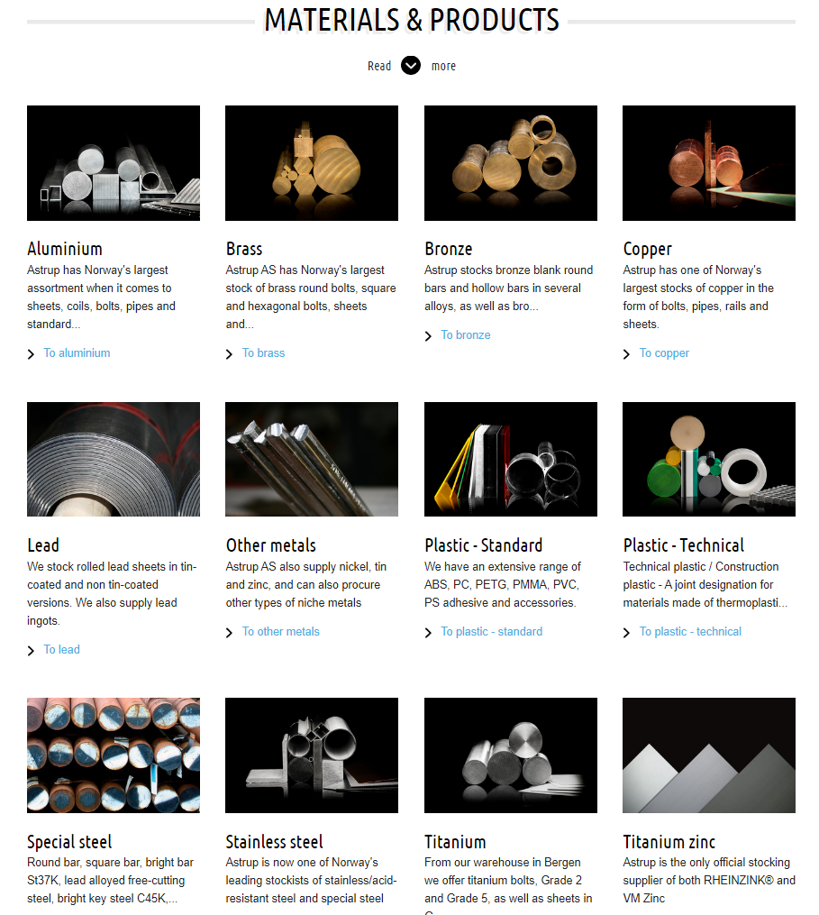
Visit us at www.astrup.no

